Slide 1
Rejuvenation biotechnology: why the longevity “problem” is going to get worse – well, different
Aubrey D.N.J. de Grey, Ph.D.
Chief Science Officer
SENS Research Foundation
aubrey@sens.org
http://www.sens.org/

Slide 2
Everything you need to know about future mortality
Most people (nowadays) die from being sick
Most sickness (nowadays) is due to aging
Aging is the accrual of living-derived damage
That damage can foreseeably be repaired

Slide 3
Everything you need to un-learn about future mortality
“Mortality rate doubling time is immutable”
“Period life expectancy will evolve smoothly”
“People will always think they’ll die when their parents did”
“Comprehensive rejuvenation is fantasy”

Slide 4
Aging in three words
Metabolism
Damage
Pathology
(life-long) (late life)

Slide 5
Three candidate approaches
Gerontology
Maintenance
Geriatrics
Metabolism
Damage
Pathology
(life-long) (late life)

Slide 6
Comparison: car maintenance

Slide 7
The “seven deadly things” & their fixes
Damage type
The maintenance approach
Cell loss, cell atrophy
Replace, using stem cells
Division-obsessed cells
Reinforce, using telomere control
Death-resistant cells
Remove, using suicide genes etc
Mitochondrial mutations
Reinforce, using backup copies
Intracellular waste products
Remove, using foreign enzymes
Extracellular waste products
Remove, using immune system
Extracellular matrix stiffening
Repair, using crosslink-breakers
Existence of any 8th is looking increasingly unlikely

Slide 8
Things you may be thinking right now
This guy looks crazy; what do “credentialed” people think about these ideas?
Even if he’s right, are the consequences for longevity big/near enough to affect my work?
Even if they are, will society let it happen?

Slide 9
Things you may be thinking right now
This guy looks crazy; what do “credentialed” people think about these ideas?
Even if he’s right, are the consequences for longevity big/near enough to affect my work?
Even if they are, will society let it happen?

Slide 10
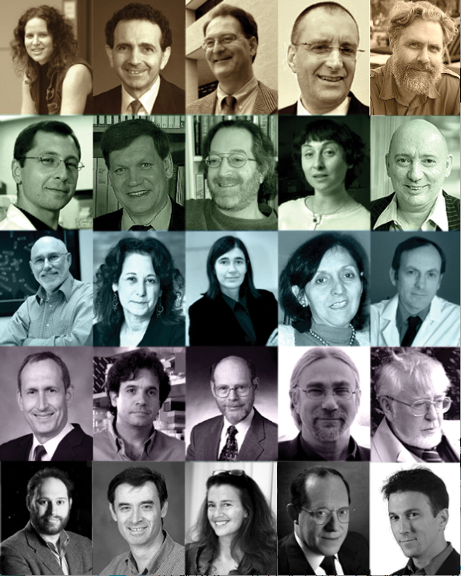
What do other experts think?
See their names, their awesome credentials and their hard-hitting endorsement of our research approach at
www.sens.org/about/leadership/research-advisory-board

Slide 11
Cell 153:1194 (2013)

Slide 12
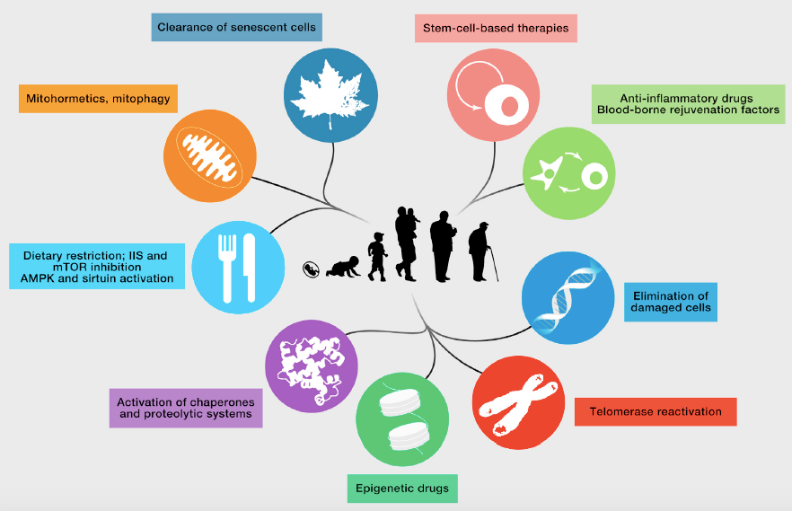
Cell 153:1194 (2013)

Slide 13
Our implementation progress
Total synthesis of glucosepane, allowing identification of antibodies and degraders (Science 2015)
Modified bacterial enzyme protects cells from atherogenic oxysterols (Biotech. Bioeng. 2012)
Catalytic antibodies chop up cardiotoxic amyloid (J. Biol. Chem. 2014)
Two out of 13 mitochondrial genes successfully relocated to the nucleus (Nucl. Acids Res. 2016)

Slide 14
Things you may be thinking right now
This guy looks crazy; what do “credentialed” people think about these ideas?
Even if he’s right, are the consequences for longevity big/near enough to affect my work?
Even if they are, will society let it happen?

Slide 15
So… longevity?
We DON’T WORK ON LONGEVITY, whatever the media may like to tell you
However, we know that this medicine may increase longevity a lot, I mean really a lot
We think this is a good thing, even though it will put people like you out of business ☺

Slide 16
How BIG is the longevity side-benefit?
Rejuvenation therapies may never be perfect; the first-generation version may give “only” ~30y extra life
However, that would buy us time to develop better ones, with which to “re-rejuvenate” the same people, and so on (“longevity escape velocity”)
So…?

Slide 17
How BIG is the longevity side-benefit?
Western mortality rate in the 20s is under 10⁻³/y
If it didn’t rise with age (and in fact it will surely fall with time), most people would live to over 1000
Period (i.e. “headline”) life expectancy will very suddenly become incalculable (literally!)

Slide 18
How NEAR is the longevity side-benefit?
This is pioneering technology, so we don’t know
Guess: 50% chance in 20-25y if funding rises soon
At least 10% chance it’ll take >100y
That’s for the therapies I’ve mentioned today
They will probably give around 30yr extra life
LEV thenceforth seems inevitable
Everyone will understand the above this decade

Slide 19
Things you may be thinking right now
This guy looks crazy; what do “credentialed” people think about these ideas?
Even if he’s right, are the consequences for longevity big/near enough to affect my work?
Even if they are, will society let it happen?

Slide 20
Sociological considerations
Overpopulation?
Inequality of access?
Immortal dictators?
Boredom?
Pensions collapse?

Slide 21
Sociological considerations
Overpopulation?
Inequality of access?
Immortal dictators?
Boredom?
Pensions collapse?

Slide 22
Sociological considerations
No age-related ill-health
Elderly contribute wealth
Energy to explore novelty
Flexible career structure
Not a burden on your kids

Slide 23
www.sens.org
aubrey@sens.org

